Slide 1

Q-ART
QR CODE AUDIO “BEACONS”
(7MU007) Musical Human-Computer Interaction – Assignment #1

Slide 2
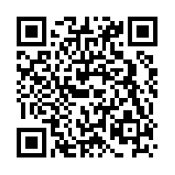
CONCEPT OVERVIEW
QR YOU READING ME?
The aim of this project is to use Quick Response (QR) Codes to allow single click, zero latency access to audio-based artistic content, or supplemental information regarding existing works of art.
If you wish to join in with the testing, please download QR Code Reader and Scanner by Kaspersky Lab, or have your own QR Code App standing by.

Slide 3
INSPIRATION
Video Game Audio Logs
Walking Simulators (e.g. Everybody’s Gone to the Rapture)
The Wolves in Wolves, and other Art Trail-style Projects
Radio Dramas
The more practical application is born from a comment heard at the Grand Arena Access Forum, discussing the phasing out of guided tours for Visually Impaired patrons at Wolverhampton Art Gallery.
This process may act as a low impact replacement, and the secondary use may aid its viability.

Slide 4
THEORETICAL BACKGROUND
Concepts such as 2D Voice, and the wider discussion of sound design in the video game Bioshock, undertaken in “Voice, videogames, and the technologies of immersion” by Ward (2010).
Given the basis in Audio Description, the limited academic sources available by Orero and Matamala in Spain, Sadowska in Poland, and even Dalgleish and Reading in the UK have influenced the project in abstract ways.
Later iterations of this product could implement the Multimedia Guides for All (MGA) methodology discussed in “Design for All in multimedia guides for museums” by Ruiz et al. (2011)

Slide 5

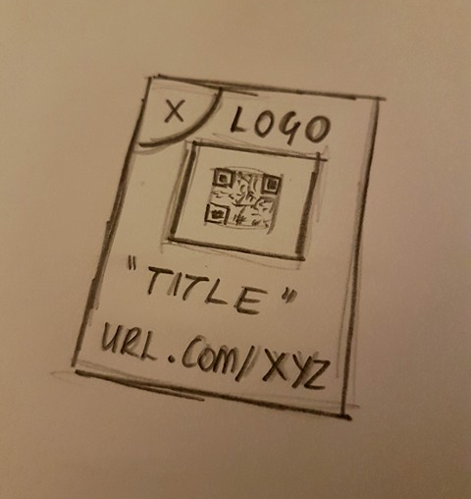
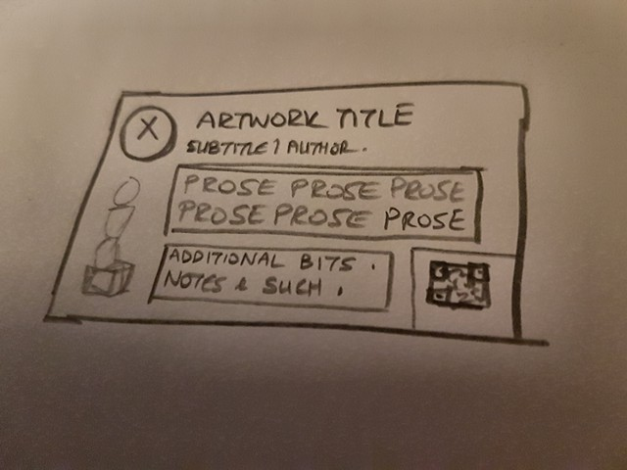
INITIAL DESIGNS
Supplemental Design
QR Focussed Design
Digital Rendering

Slide 6
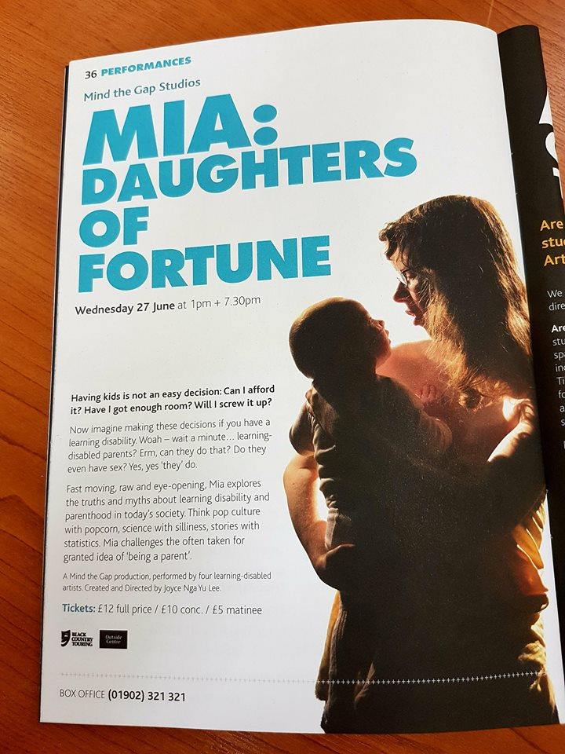
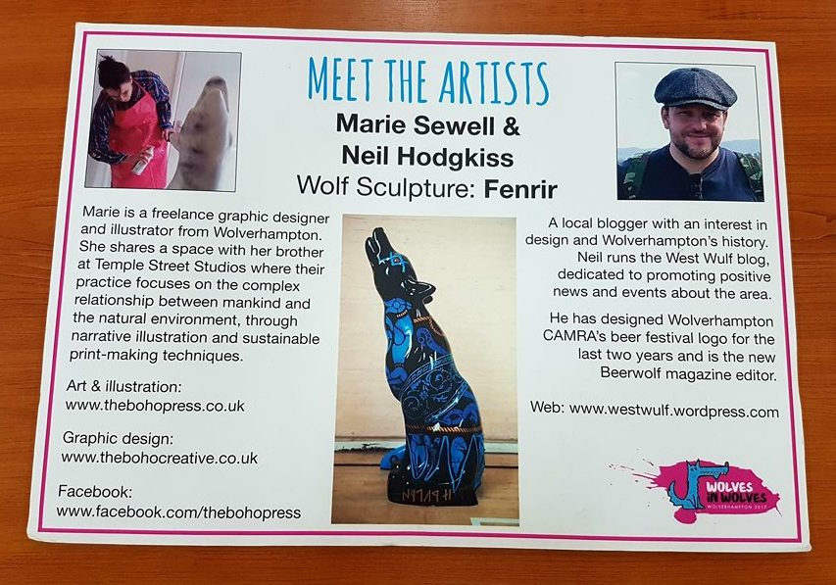
EXISTING SOURCES

Slide 7
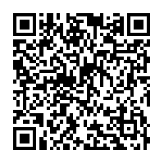
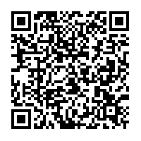
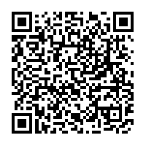
FINAL PRODUCTS

Slide 8
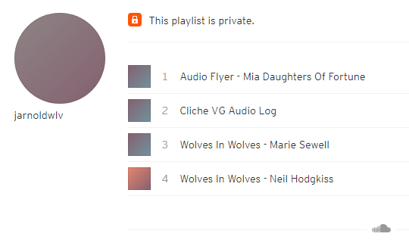
IMPLEMENTATION
SUBTITLE
Audio samples were recorded in a number of different ways, mixed, and – where necessary – converted to the correct file type.
These files were uploaded to a SoundCloud account as a private album.
A QR Code was then created via QRstuff.com, with the image then being added to the necessary template to produce our “Beacon”.

Slide 9
DEMONSTRATION

Slide 10
ADVANCEMENT / IMPROVEMENT
SUBTITLE
There are opportunities to improve and enhance the product.
A purpose built application and/or hosting method could eliminate/guarantee a maintained low click, low latency user interface.
For VI users, a tactile surface may help to identify “Beacons”. Potential implementation of a secondary data distribution method that doesn’t rely on visual confirmation, such as an RFID chip alongside or under the QR code might be viable.

Slide 11
REFERENCES
Author Unknown (2017) Please just give me an B so I can go home and drink wine. Me.me. [online]. [Accessed 22 April 2018]. Available at: https://me.me/i/please-just-give-me-an-b-so-can-go-home-18646357.
AO Kaspersky Lab (2015) Kaspersky QR Scanner [mobile app] Version 1.1.1.137. [Accessed 22 April 2018]. Available from: Google Play Store.
The Chinese Room & SCE Santa Monica Studios (2015) Everybody’s Gone to the Rapture [video game]. Los Angeles, California: Sony Computer Entertainment
Various Artists (2017) Wolves in Wolves 2017 [Outdoor Exhibition]. Various Locations, Wolverhampton.
2k Boston and 2k Australia (2007) BioShock [video game]. Novato, California: 2k Games
Ward, M. (2010) Voice, videogames, and the technologies of immersion. in N. Neumark, R. Gibson & T.V. Leeuwen (eds), Voice: vocal aesthetics in digital arts and media [online]. Cambridge, Mass: MIT Press, pp.267-279. [Accessed 22 April 2018]. Available at: https://www.researchgate.net/profile/Mark_Ward3/publication/236202685_Ward_M_2010_%27Voice_videogames_and_the_technologies_of_immersion%27_in_N_Neumark_R_Gibson_TV_Leeuwen_eds_Voice_vocal_aesthetics_in_digital_arts_and_media_MIT_Press_Cambridge_Mass_pp_267-279/links/57b253a108ae0101f17a5d25/Ward-M-2010-Voice-videogames-and-the-technologies-of-immersion-in-N-Neumark-R-Gibson-TV-Leeuwen-eds-Voice-vocal-aesthetics-in-digital-arts-and-media-MIT-Press-Cambridge-Mass-pp-267-279.pdf
Orero, P. and Matamala, A. (2014) Standardising Audio Description. Italian Journal of Special Education for Inclusion [online]. 1, pp.149-155. [Accessed 22 April 2018]. Available at: https://www.researchgate.net/publication/251493582_Standarising_Audio_Description.
Sadowska, A. (2017) Selected strategies in audio description – a reception study on user preferences [online]. [Accessed 22 April 2018]. Available at: http://grupsderecerca.uab.cat/arsad/sites/grupsderecerca.uab.cat.arsad/files/sadowska_arsad_2017.pdf
Dalgleish, M. and Reading, N. (2017) Reproduced Sound 2017 - Sound Quality by Design: plus any additional information. [online]. Nottingham University, 21-23 November 2017. [Accessed 22 April 2018]. Available at: http://wlv.openrepository.com/wlv/handle/2436/620895.
Ruiz, B. et al. (2011) Design for All in multimedia guides for museums. in Lytras, M. & Carroll, J. (eds), Computers in Human Behavior [online]. 27(4) pp.1408-1415. [Accessed 22 April 2018] Available at: https://www.sciencedirect.com/science/article/pii/S0747563210002402.
Sewell, M. and Hodgkiss, N. (2017) Wolves in Wolves #25 – “Fenrir” [Painted Sculpture]. Arena Theatre, Wolverhampton.
arenatheatre3 (2017) Arena Theatre, Wolverhampton Brochure Spring 2018 [online]. [Accessed 22 April 2018]. Available at: https://issuu.com/arenatheatre3/docs/arena-brochure-spring-2018-hi-res.
Jarnoldwlv (2018) QR Code Resources [online]. [Accessed 15 May 2018]. Available at: https://soundcloud.com/user-374109182/sets/qr-code-resources.
Denso Wave Incorporated (2017) QRStuff [online]. [Accessed 22 April 2018] Available at: https://www.qrstuff.com/.

